Slide 1
DTMC – Discrete Time Markov Chains
Christian M. Adriano (Chris)
christian.adriano@hpi.de
Notes:
https://en.wikipedia.org/wiki/Transduction_(machine_learning)

Slide 2
Topics
Intro to mRubis
Communication plan
Project-1 description

Slide 3
Communicantion Plan
Motive | Content | Medium
Artifacts | Source code, Data Documentation, Wiki | Github - https://github.com/orgs/hpi-sam/
Papers | Copyrighted material | Bib-Admin
Messaging ad hoc | Questions, Suggestions, Sharing | Slack
Official communications | Schedule, Orientations | Email
Meetings | Lectures, Status, Work meetings | Zoom, Skype
Emergency | Call, SMS, messaging | Chris mobile number

Slide 4
Project-1: Use of DTMC to Predict Event Masking

Slide 5
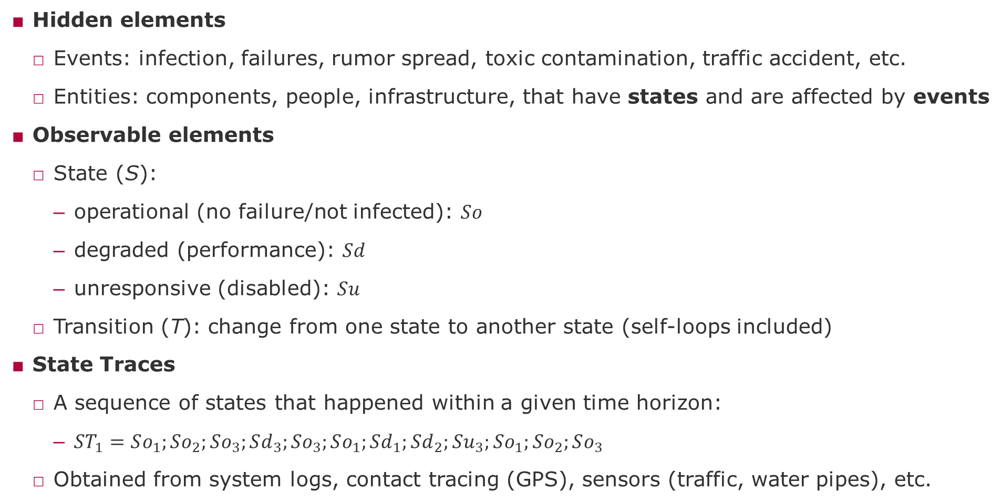
Definitions for the DTMC project
Hidden elements
Events: infection, failures, rumor spread, toxic contamination, traffic accident, etc.
Entities: components, people, infrastructure, that have states and are affected by events
Observable elements
State (S):
operational (no failure/not infected): $So$
degraded (performance): $Sd$
unresponsive (disabled): $Su$
Transition (T): change from one state to another state (self-loops included)
State Traces
A sequence of states that happened within a given time horizon:
$ST_{1}=So_{1};So_{2};So_{3};Sd_{3};So_{3};So_{1};Sd_{1};Sd_{2};Su_{3};So_{1};So_{2};So_{3}$
Obtained from system logs, contact tracing (GPS), sensors (traffic, water pipes), etc.

Slide 6
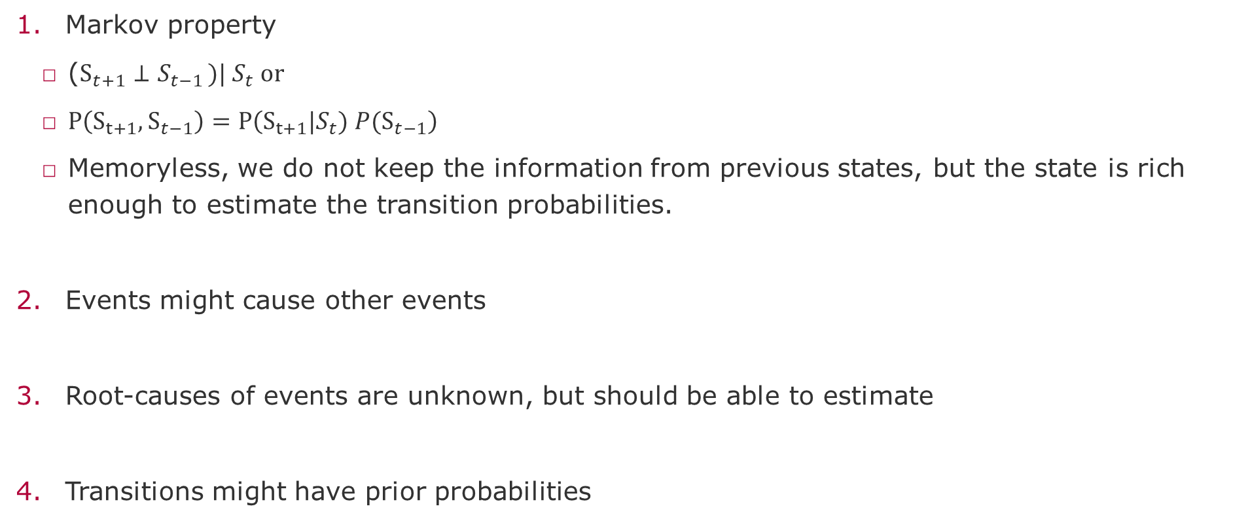
Assumptions
Markov property
($S_{t+1}⊥S_{t−1 })| S_{t} or$
$P\left(S_{t+1},S_{t−1}\right)=P\left(S_{t+1}|S_{t}) P(S_{t−1}\right)$
Memoryless, we do not keep the information from previous states, but the state is rich enough to estimate the transition probabilities.
Events might cause other events
Root-causes of events are unknown, but should be able to estimate
Transitions might have prior probabilities

Slide 7

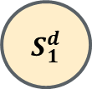
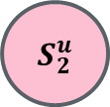
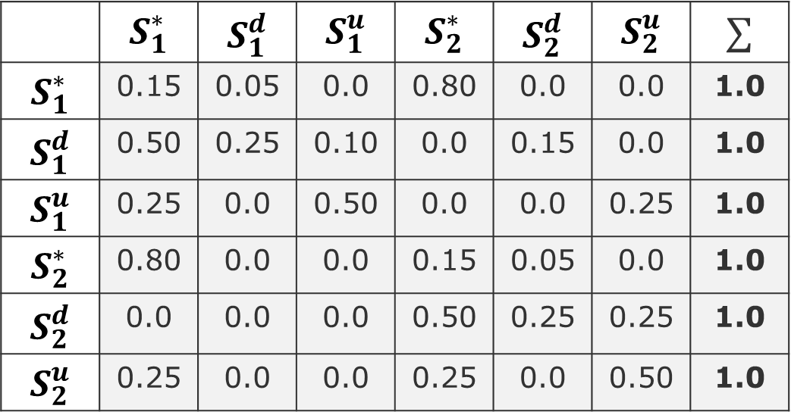
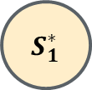
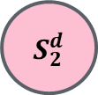
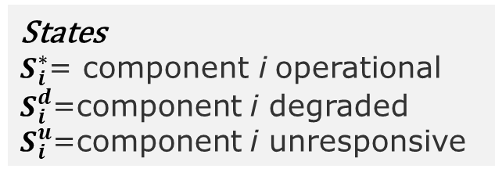
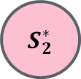
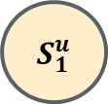
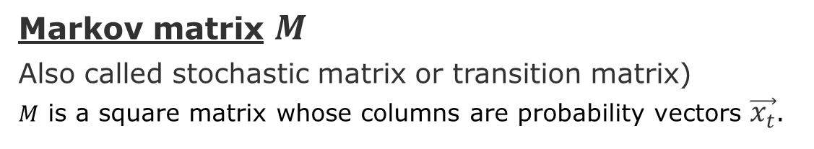
Example of Markov Chain
States
$S_{i}^{∗}$= component i operational
$S_{i}^{d}$=component i degraded
$S_{i}^{u}$=component i unresponsive
Markov matrix $M$
Also called stochastic matrix or transition matrix)
$M$ is a square matrix whose columns are probability vectors $\vec{x_{t}}$.
Target states
$$S_{1}^{∗}$$
$$S_{1}^{d}$$
 | $$S_{1}^{∗}$$ | $$S_{1}^{d}$$ | $$S_{1}^{u}$$ | $$S_{2}^{∗}$$ | $$S_{2}^{d}$$ | $$S_{2}^{u}$$ | $$∑$$
$$S_{1}^{∗}$$ | 0.15 | 0.05 | 0.0 | 0.80 | 0.0 | 0.0 | 1.0
$$S_{1}^{d}$$ | 0.50 | 0.25 | 0.10 | 0.0 | 0.15 | 0.0 | 1.0
$$S_{1}^{u}$$ | 0.25 | 0.0 | 0.50 | 0.0 | 0.0 | 0.25 | 1.0
$$S_{2}^{∗}$$ | 0.80 | 0.0 | 0.0 | 0.15 | 0.05 | 0.0 | 1.0
$$S_{2}^{d}$$ | 0.0 | 0.0 | 0.0 | 0.50 | 0.25 | 0.25 | 1.0
$$S_{2}^{u}$$ | 0.25 | 0.0 | 0.0 | 0.25 | 0.0 | 0.50 | 1.0
$$S_{1}^{u}$$
Source states
$$S_{2}^{u}$$
$$S_{2}^{∗}$$
$$S_{2}^{d}$$
$$\vec{x_{t}}$$
Intentionally not showing the self-loops

Slide 8

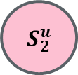
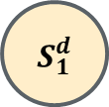

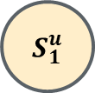
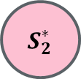
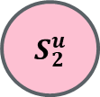
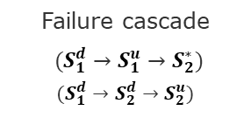
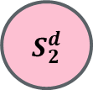
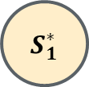
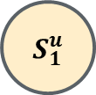

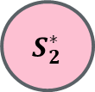
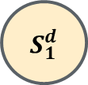
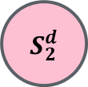

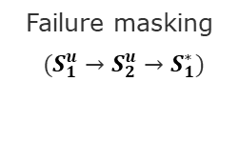
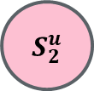
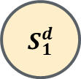
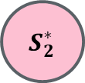
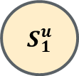
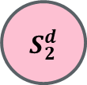
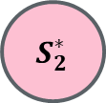
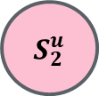
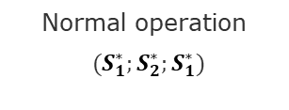
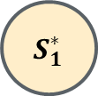

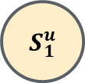

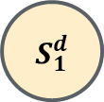
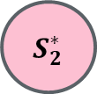
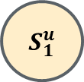

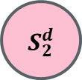
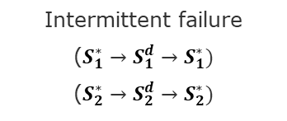
Types of Traces
$$S_{1}^{∗}$$
$$S_{1}^{d}$$
$$S_{1}^{∗}$$
$$S_{1}^{d}$$
$$S_{1}^{∗}$$
$$S_{1}^{d}$$
$$S_{1}^{∗}$$
$$S_{1}^{d}$$
$$S_{1}^{∗}$$
$$S_{1}^{d}$$
$$S_{1}^{u}$$
$$S_{1}^{u}$$
$$S_{1}^{u}$$
$$S_{1}^{u}$$
$$S_{1}^{u}$$
$$S_{2}^{u}$$
$$S_{2}^{u}$$
$$S_{2}^{u}$$
$$S_{2}^{u}$$
$$S_{2}^{u}$$
$$S_{2}^{∗}$$
$$S_{2}^{d}$$
$$S_{2}^{∗}$$
$$S_{2}^{d}$$
$$S_{2}^{∗}$$
$$S_{2}^{d}$$
$$S_{2}^{∗}$$
$$S_{2}^{d}$$
$$S_{2}^{∗}$$
$$S_{2}^{d}$$
Normal operation
$(S_{1}^{∗};S_{2}^{∗};S_{1}^{∗})$
Intermittent failure
($S_{1}^{∗}→S_{1}^{d}→S_{1}^{∗})$
($S_{2}^{∗}→S_{2}^{d}→S_{2}^{∗})$
Systemic degradation
($S_{1}^{d}→S_{2}^{d})$
Failure masking
$(S_{1}^{u}→S_{2}^{u}→S_{1}^{∗})$
Failure cascade
$(S_{1}^{d}→S_{1}^{u}→S_{2}^{∗})$
$$(S_{1}^{d}→S_{2}^{d}→S_{2}^{u})$$

Slide 9

Sympy basics https://docs.sympy.org/latest/modules/stats.html
>>x = symbols(“x”)
x
>> sqr(x)
$\sqrt{x}$
>>N(sqrt(2))
1.4142135623731
>> x=3
>> Eq(x,3) #Eq compare two values
True
#P Probability that a condition is true, optionally given a second condition
>> P(Eq(x,5), x > 1) # Probability that x == 5 given that x > 2
False

Slide 10
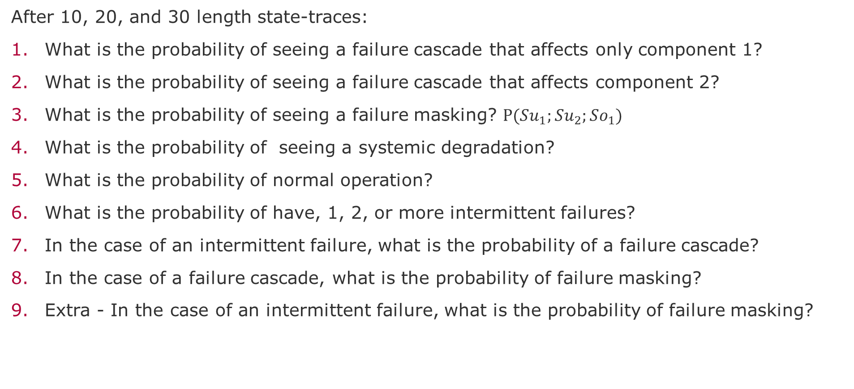
Questions to answer
After 10, 20, and 30 length state-traces:
What is the probability of seeing a failure cascade that affects only component 1?
What is the probability of seeing a failure cascade that affects component 2?
What is the probability of seeing a failure masking? $P(Su_{1};Su_{2};So_{1})$
What is the probability of seeing a systemic degradation?
What is the probability of normal operation?
What is the probability of have, 1, 2, or more intermittent failures?
In the case of an intermittent failure, what is the probability of a failure cascade?
In the case of a failure cascade, what is the probability of failure masking?
Extra - In the case of an intermittent failure, what is the probability of failure masking?

Slide 11
Task instructions
Form a group and send the name of members to Chris (who will create a Slack channel for each)
Accept Slack invite and GitHub project
Install Sympy (https://docs.sympy.org/latest/modules/stats.html)
Steps
Build Markov Chain for the 18 components and the 3 types of states
Generate the transitions using the dependency data*
Apply a transition log data* to estimate (learn) the transition matrix
Plot the transition matrix (suggest ways to visualize the convergence to steady state)
Identify the types of paths
*Excel file: mRubis_Transition_Matrix.xlsx

Slide 12
End

Slide 13
Supervisory Component

Slide 14
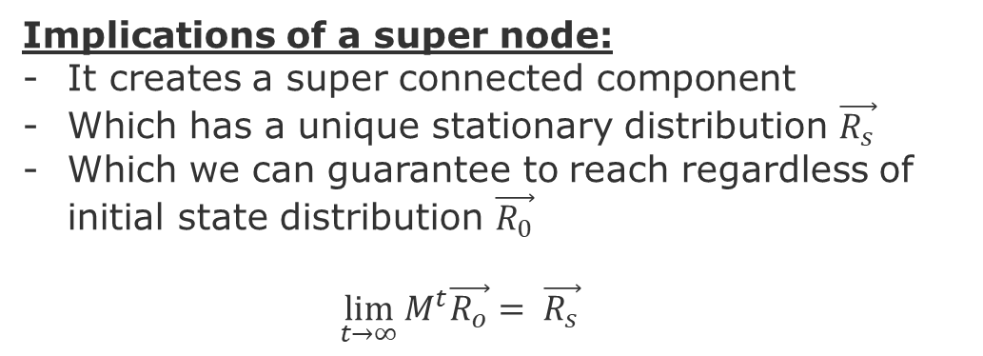
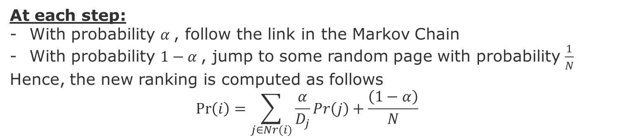
Dead-Ends [Brin, Page, Motwani & Winograd 99]
Super Node
Implications of a super node:
It creates a super connected component
Which has a unique stationary distribution $\vec{R_{s}}$
Which we can guarantee to reach regardless of initial state distribution $\vec{R_{0}}$
$$\lim_{t→∞}{M^{t}\vec{R_{o}}}= \vec{R_{s}}$$
Teleports
Hub
E
H
A
F
Lose, dangling node
(dead-end)
B
G
C
D
Authority
At each step:
With probability $α$, follow the link in the Markov Chain
With probability $1−α$, jump to some random page with probability $\frac{1}{N}$
Hence, the new ranking is computed as follows
$$\operatorname{Pr}\left(i\right)=\sum_{j∈Nr(i)}{\frac{α}{D_{j}}Pr\left(j\right)}+\frac{\left(1−α\right)}{N}$$
Page, L., Brin, S., Motwani, R., & Winograd, T. (1999). The PageRank citation ranking: Bringing order to the web. Stanford InfoLab.

